Slide 1
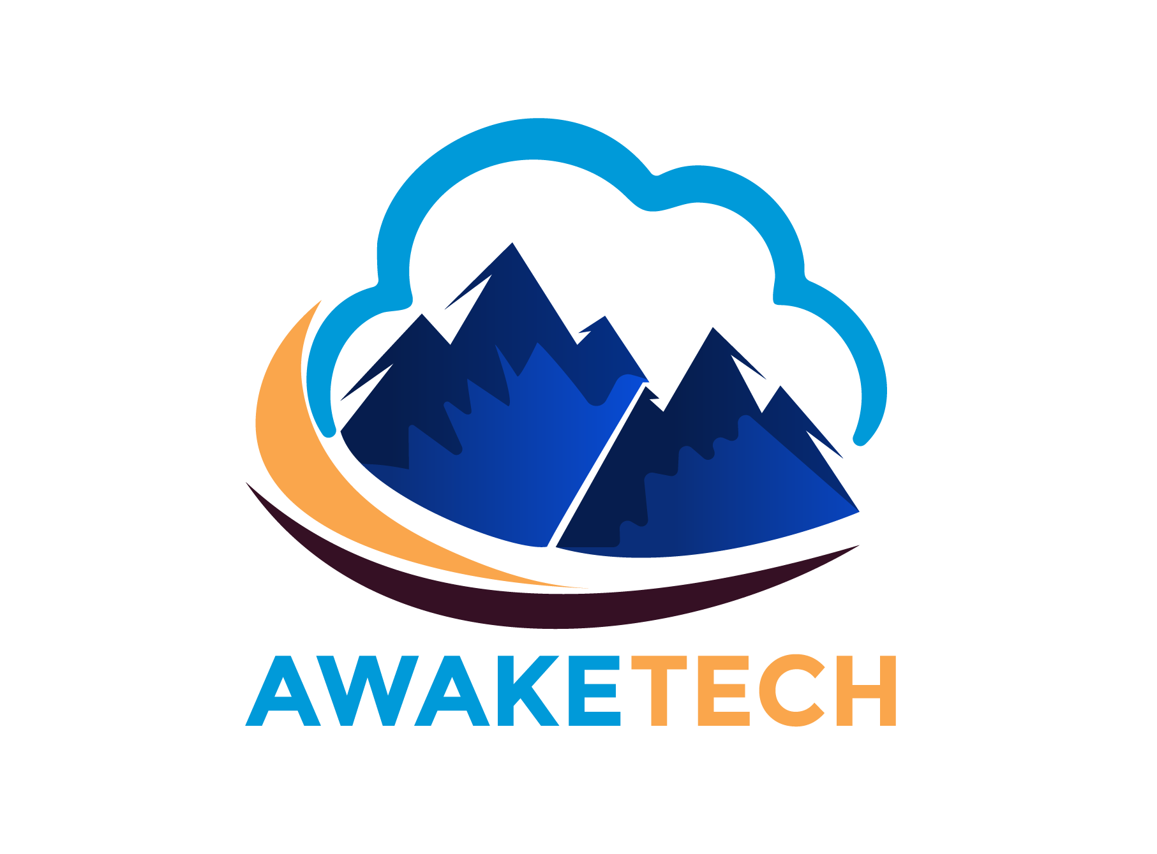
DevOps Introduction
&
Cultural Process

Slide 2
Intro
AwakeTech was founded in 2020 with one goal to provide innovate and smart solutions to our clients with our innovative solutions. A new team with lots of years of experience in DevSecOps and Cloud fields. Whether your organization is reinventing itself or simply running it’s existing business, the key to successfully pull this off is through digital engineering.

Slide 3

Intro
Founder / CEO / DevOps Engineer
Past experience:
Senior DevOps Engineer at Express.
Education: B.Sc.C.S.IT, ACHS College
Community:
Member of DevOps KTM Meetup. Board Member of IBMC.
Board Member of BSON.
Corporate Trainer: Jobaxle, Swift, Techaxis

Slide 4
Vision
Compete DevSecOps Global Market
Contribute to IT industry in Nepal
Employment program in Country
Build DevSecOps Community
Develop DevSecOps solution inhouse and provide software globally.
Educate people for IT, Cloud, Security and DevOps skills.

Slide 5
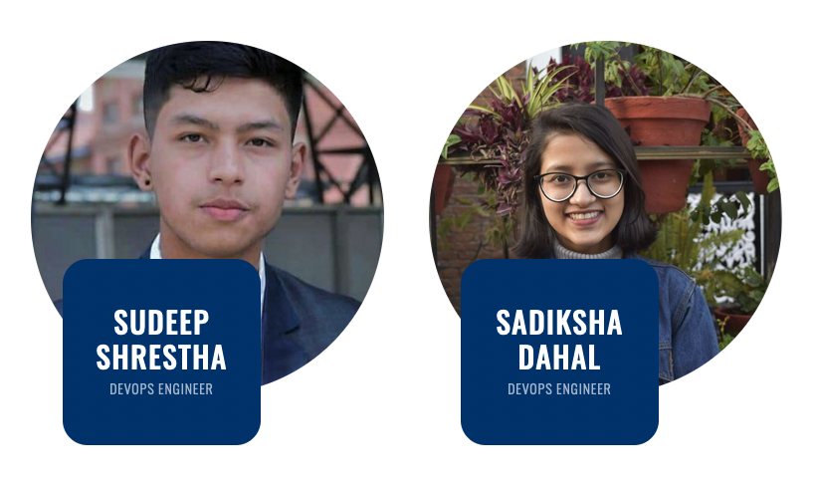
Instructor

Slide 6
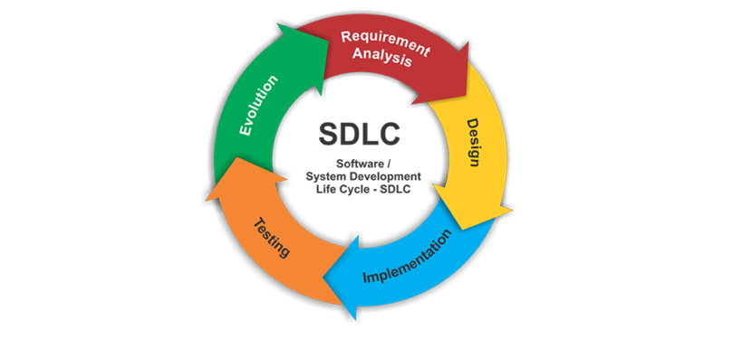
SDLC

Slide 7
DevOps?
People who can handle server and update them via scripts and they automate the things.

Slide 8

Really ?

Slide 9
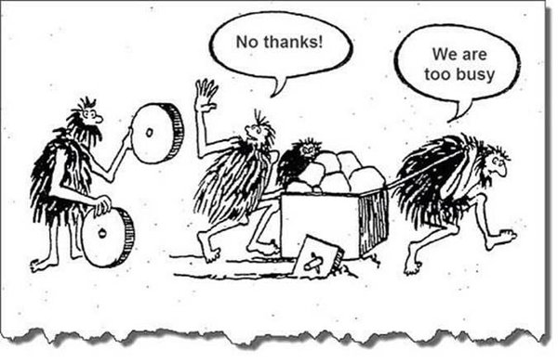
Before DevOps…….
New guy
Team

Slide 10
Let’s Clear on…..
What is not DevOps?

Slide 11

Not simply combination of Development & Operations teams
Developers
Operations
Combining two teams and calling it DevOps cannot accomplish those practices.

Slide 12

2. DevOps is not a separate team
Blame Game !!!
Creation of these teams can lead to further confusion when the mission is not clearly defined.
But Some Organization can have separate devops team depending upon goals and situation and expertise requirements.

Slide 13
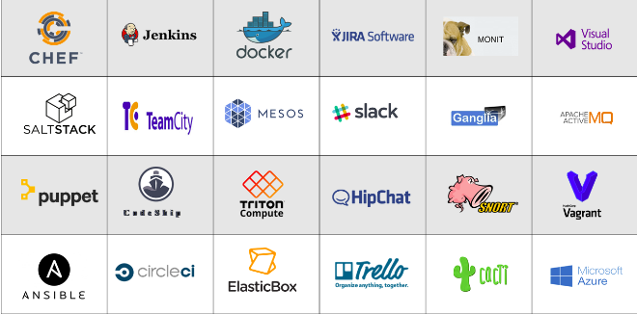
3. DevOps is not a tool and automation.

Slide 14
4. Not a body of knowledge.
No central authority and no DevOps standard.
There is no single “right way” to go down the DevOps road.
Each organisation has different challenges and takes a different path along their DevOps journey, which can all be valid.

Slide 15
5. DevOps is not a one-size-fits-all strategy
Just because we used it on the last project doesn’t make it a silver-bullet fix for the next one.
Thus, we need to first understand our current strategy and environment, then react accordingly.
Embrace change, gather metrics, understand feedback, fail fast and correct issues quickly and early.
That’s why we need Continuous Learning attitude.

Slide 16
DevOps Enlightenment Time

Slide 17
What is DevOps?
Combinations of cultural philosophies, practices and tools that increases organization’s ability to deliver applications and services at high velocity and makes everyone more collaborative and responsive to change.

Slide 18
CALMS
Culture
Sharing
Automation
Measurements
Lean

Slide 19
Culture
Focus on people.
Encourage to collaboration & communication.
Continuous Improvement.
Help People understand DevOps.

Slide 20
Automation
Focus on Continuous Delivery.
Environment setup.
Chat Bot.
Continuous Integration and Continuous Deployment.
Continuous Testing and Continuous Monitoring.

Slide 21
Lean
Focus on the value.
Asking better questions to the clients.
Lead time: Visualizing Productions metrics.
Case studies.

Slide 22
Measurements
Provide feedback to everyone.
Failures in production and when it is fixed.
The number of defects that are found during a given unit of time.
Change lead time (Duration of new release in production).
The percentage of tickets mapped to releases.
The percentage of unplanned issues.

Slide 23

Sharing
Collaboration &
Communication.

Slide 24
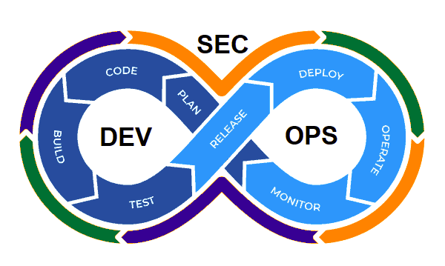
In Conclusion
To develop the culture which combines Agile Continuous Delivery Automation for bringing higher value to the customers.

Slide 25
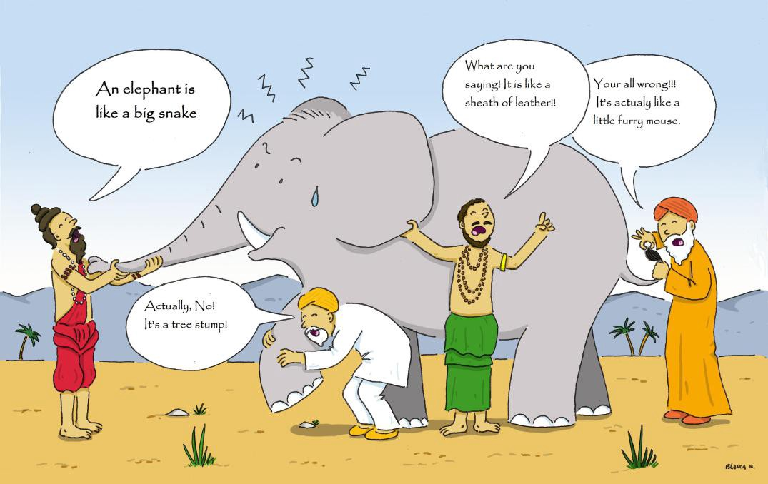

Slide 26
Questions ?

Slide 27
Thank you !!!

